Slide 1
Sales BI
Building the Data Pipeline Project
Gitlab: git@gitlab2.bigdata220uw.mooo.com:jayadv/Team6_Assignment.git
Team 6:
Maria Mendoza
Jayadev Vallath
Alexander Mendoza

Slide 2
Use Case – Low Latency
The use case is focused on reporting which paint sales representatives have reached their gallon goal for the day which would qualify them for certain incentives and bonuses.
This scenario is critical, especially on the last day of the month and a real-time reporting of their progress is crucial to help their territory directors determine who to call in case they need help moving products
Metrics would be actual gallons sold vs plan and trend
In this low-latency scenario, we will be using Postgres as the database to house all the necessary information and we will use Kafka as our messaging tool.
The output would highlight which sales reps have already attained their goal

Slide 3
High Level Architecture
Entity B
Sales Representative
Sales Rep Id | Sales Rep Name | Sales Rep Territory | Daily Gallon Plan
1-001 | John Smith | NE | 500
1-002 | Linda Errico | SE | 1000
1-003 | Ed Snith | NYC | 3000
1-004 | Dennis Brunzell | GL | 2000
1-005 | Carl Kowaski | WC | 1000
1-006 | Jung Lim | NYC | 1000
1-007 | Andy Jerkin | NE | 500
1-008 | Carla Pollak | WC | 2000
1-009 | Samson Smith | TX | 4000
1-010 | Lori Ann Curt | SE | 3000
Territory
Territory ID | Territory Name
NE | North East
SE | South East
NYC | New York Metro
GL | Great Lakes
WC | West Coast
TX | Texas
Product
Product Id | Gallons
N001 | 5
A001 | 5
C005 | 0.5
M004 | 0.25
N005 | 0.5
Entity A
Transaction
Order Date | Order Time | Sales Rep Id | Product Id | Units Sold
May 31 2016 | 8:00 AM | 1-001 | N001 | 16
May 31 2016 | 8:00 AM | 1-001 | A001 | 10
May 31 2016 | 8:00 AM | 1-001 | M004 | 15
May 31 2016 | 8:00 AM | 1-001 | N005 | 18
May 31 2016 | 9:15 AM | 1-010 | C005 | 20

Slide 4
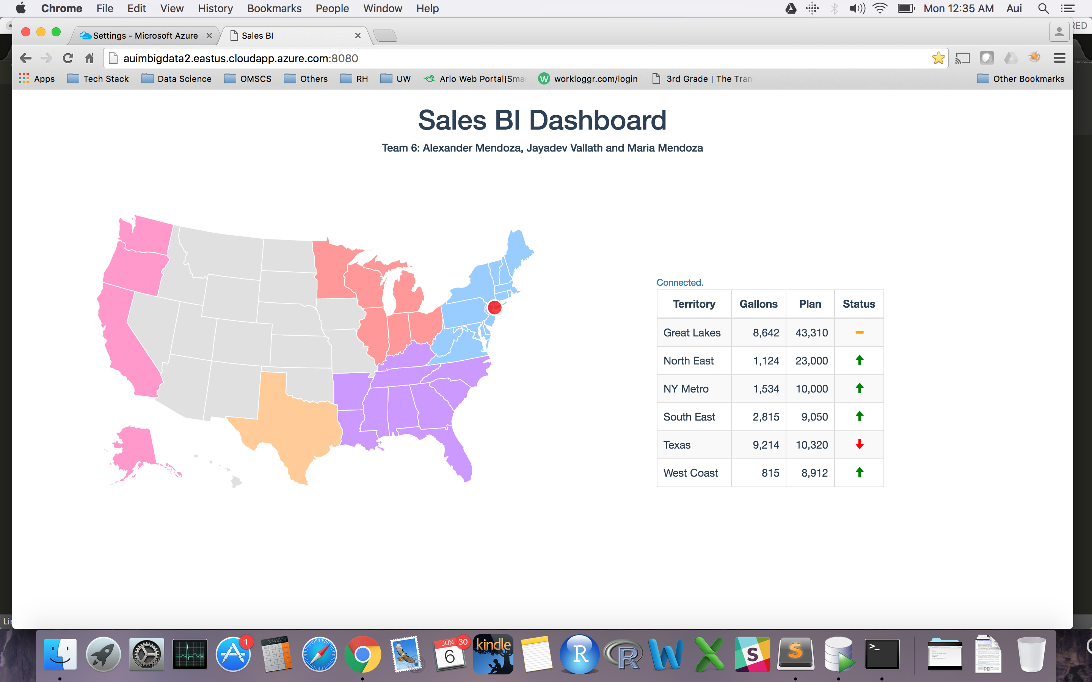
Results
Link: https://www.youtube.com/watch?v=Wblk_z_AffQ (actual video on next page)
The map changes color based on actual gallons sold vs the plan
As the messages arrive, the gallons column gets updated
The Status updates based on the average between the transactions

Slide 5
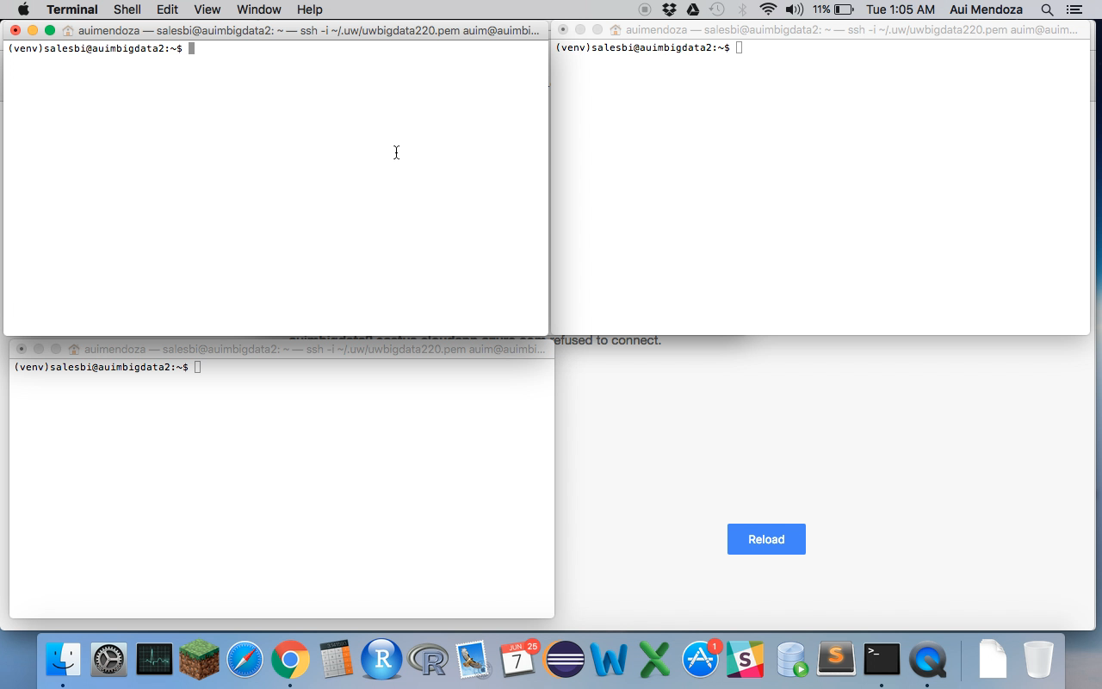
Actual Results Video

